Slide 1

Analysis Of Noise Pollution in Delhi-NCR
Team :- Eco-Engineers
Identifying Hotspots, Analyzing Trends, and Predicting Future Levels
Priyanshu Sharma 2024201046
Vaibhav Jain 2024201023
Vatsal Gupta 2024201065
Suraj Lalwani 2024201071
Niket Mittal 2024201076

Slide 2
Introduction
Urban noise pollution is a significant environmental stressor in Delhi NCR, impacting public health, well-being, and overall quality of life.
This study examines:
The distribution of noise pollution across different zones.
Temporal patterns (daily and weekly) in noise levels.
The development of a predictive model(LightGBM) for forecasting noise hotspots.
The creation of an interactive dashboard for scenario analysis.

Slide 3
Discussion & Implications
Our analysis reveals a city with clear, predictable noise hotspots driven by traffic that consistently violate national standards.
The data provides a strong evidence base for creating targeted, data-driven noise pollution policies.
The predictive model can shift enforcement from being reactive to proactive, allowing authorities to anticipate noise events.

Slide 4

Data and Methodology
Multi-year noise data from CPCB monitoring network.
Geospatial data for Delhi NCR administrative boundaries.
Consolidated and cleaned raw data from multiple stations.
Exploratory data analysis for summary statistics.
Spatiotemporal analysis to map hotspots.
Predictive model using LightGBM for forecasting.
Interactive dashboard developed in React for visualization.

Slide 5
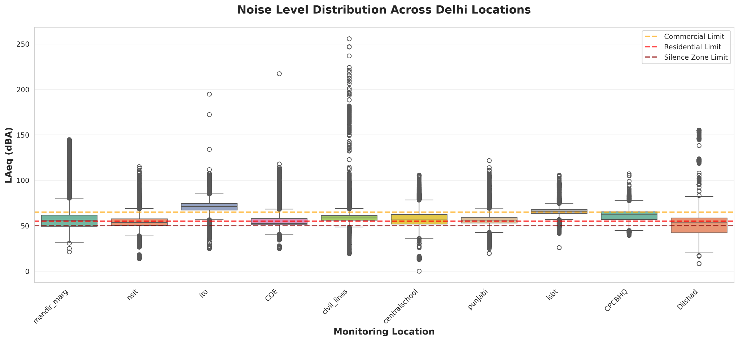
Station Rankings & Noise Profile
Noise pollution varies significantly across different zones
ITO station consistently records the highest average noise levels
The data indicates non-uniform distribution of noise pollution
Visualizations will further illustrate the comparative noise profiles
Station Rankings (Avg.Noise) | Average dBA
ito | 70.61
isbt | 65.61
CPCB_HQ | 61.04
civil_lines | 59.11
centralschool | 57.28

Slide 6
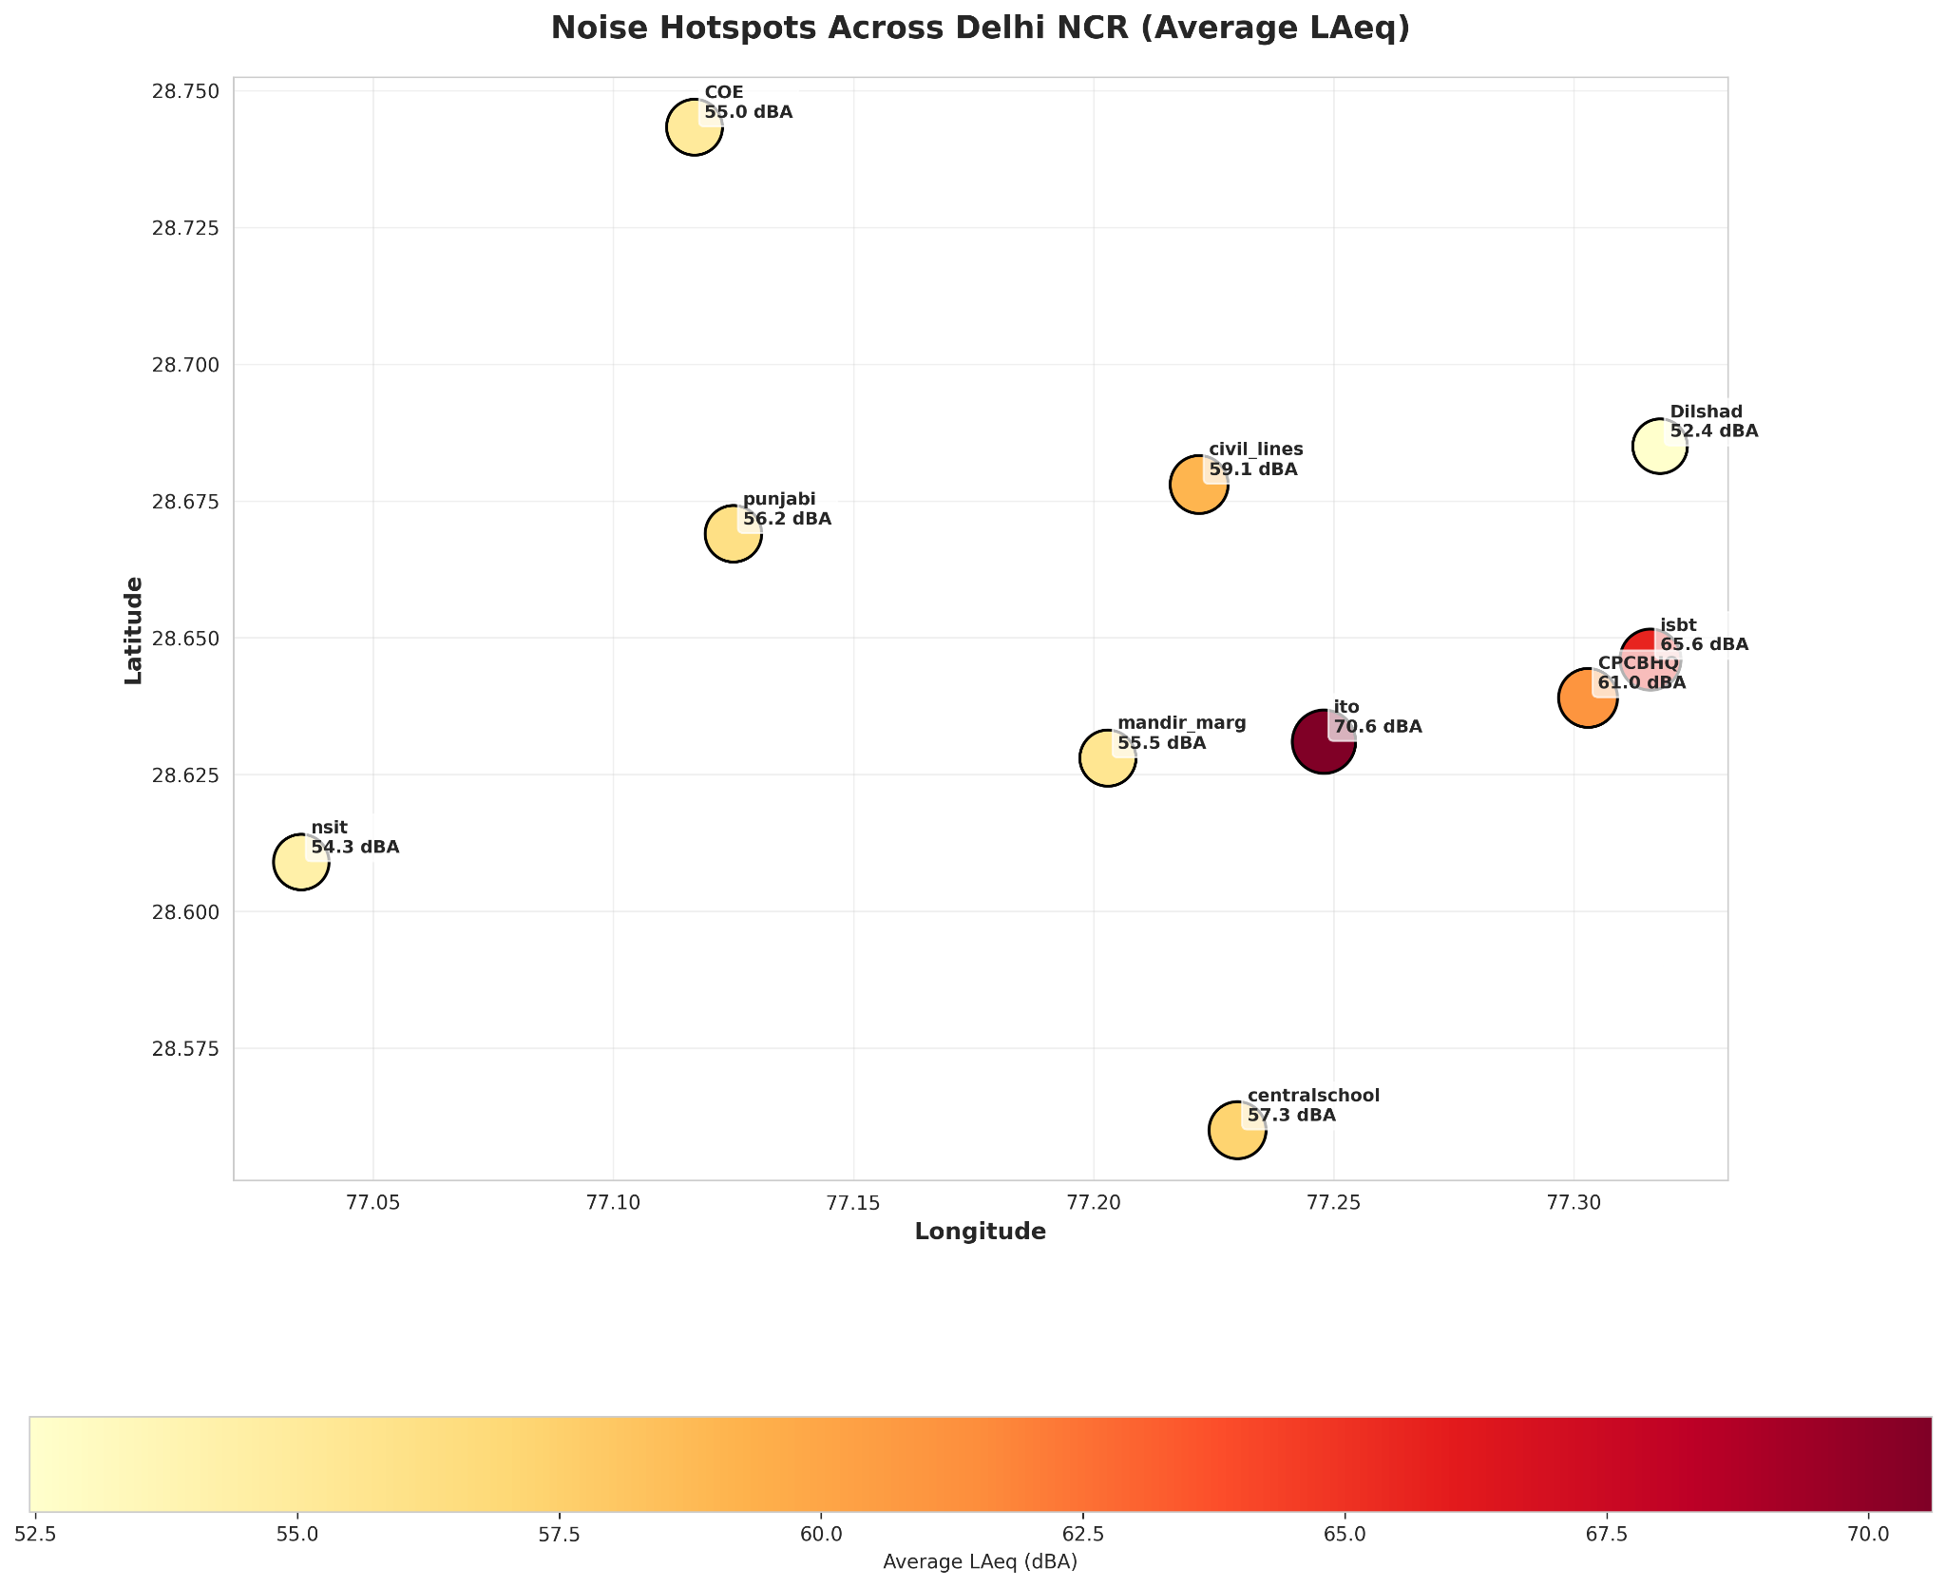
Noise Hotspot Identification
Noise pollution is concentrated in specific areas
Hotspots correlate with major traffic intersections
Hotspots are also present in commercial hubs

Slide 7
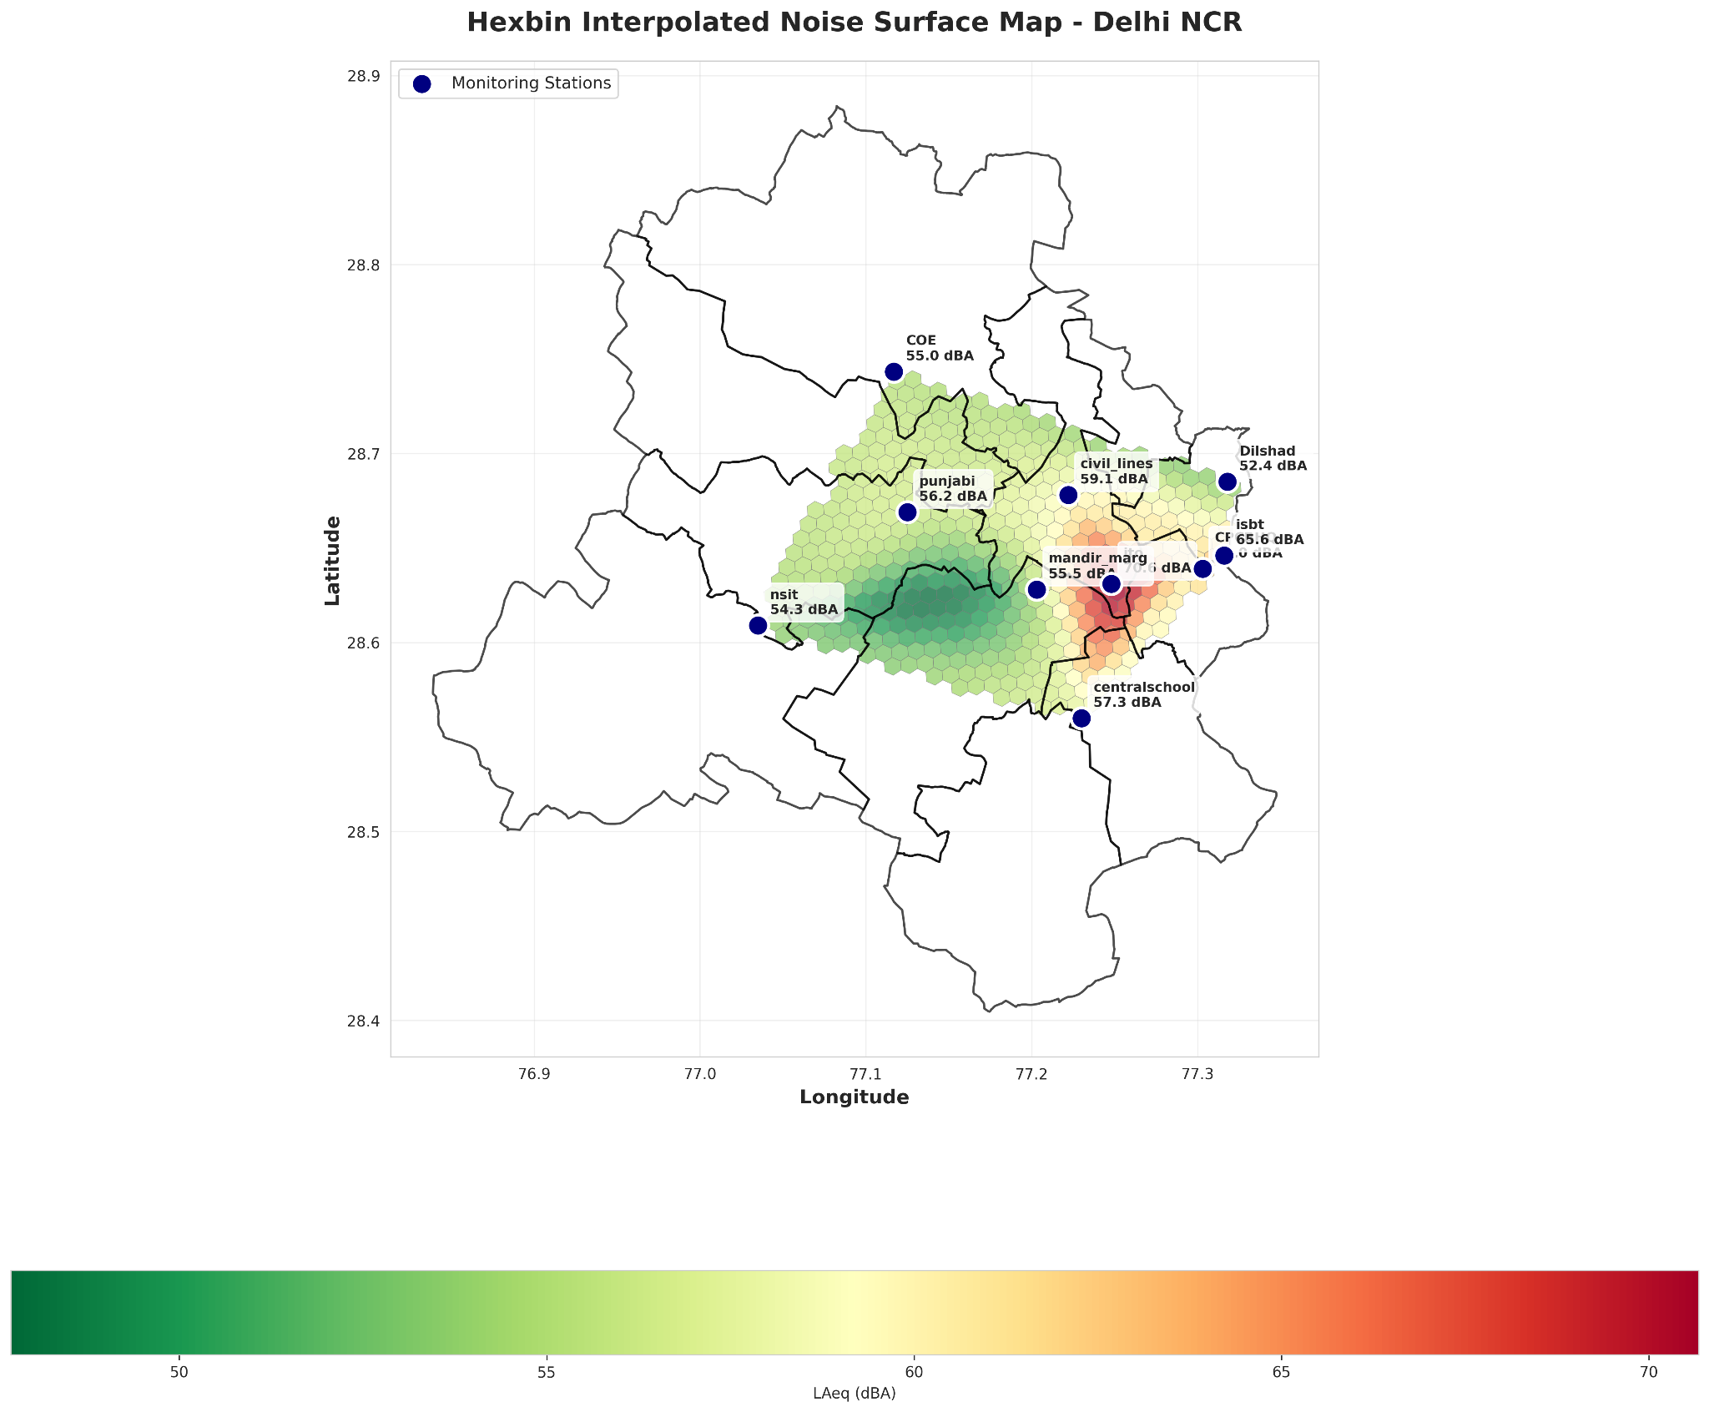
Spatial Analysis: Noise Interpolation
Importance: While monitoring stations give us precise data for specific points, they don't tell us about the noise levels in the vast areas between them.
What this map shows: This hexbin map uses spatial interpolation to estimate the noise levels across the entire city, creating a continuous "noise landscape."
Key Insight: It reveals that high-noise zones are not just isolated points but larger, continuous areas, particularly along major traffic corridors. This provides a more realistic view of population exposure to noise pollution.

Slide 8
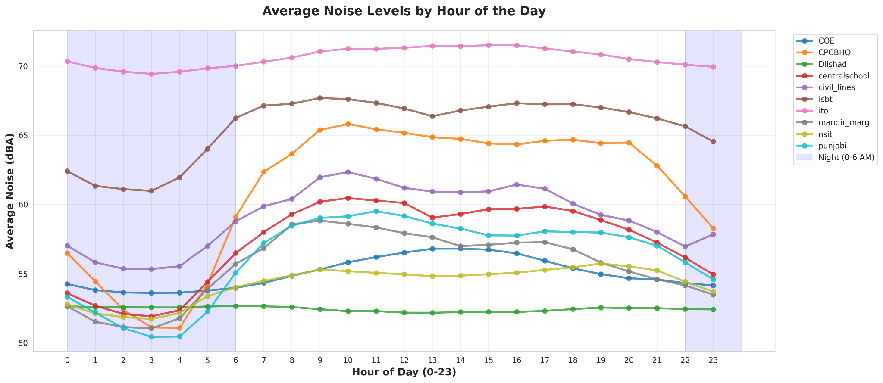
Daily Noise Patterns
Delhi has a predictable daily noise pattern driven by traffic.
Clear morning (9-11 AM) and evening (6-8 PM) peaks are visible.
Key Hourly Averages | Average dBA
Quietest Hour (4 AM) | 54.79
Morning Peak (10 AM) | 60.83
Evening Peak (6 PM) | 60.29

Slide 9
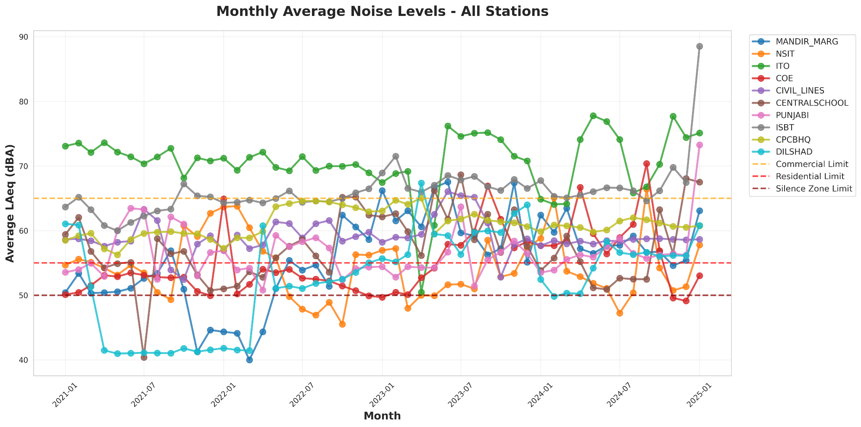
Seasonal Noise Patterns
Noise levels show distinct seasonal patterns
Winter months have highest noise levels
Monsoon months show a significant dip in noise
Meteorological conditions influence noise patterns

Slide 10
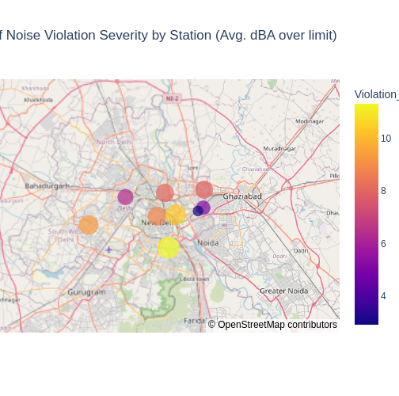
Noise Violation Analysis
CPCB noise standards are frequently exceeded
Nighttime violations are nearly universal in all zones
Central school has 98.8% night exceedance
ITO reports a high violation severity of 10.36 dBA
Location | Zone | Night Exceedance (%) | Violation Severity (dBA)
centralschool | Silence | 98.8% | 11.30
ito | Commercial | 97.0% | 10.36
nsit | Silence | 98.1% | 9.37

Slide 11
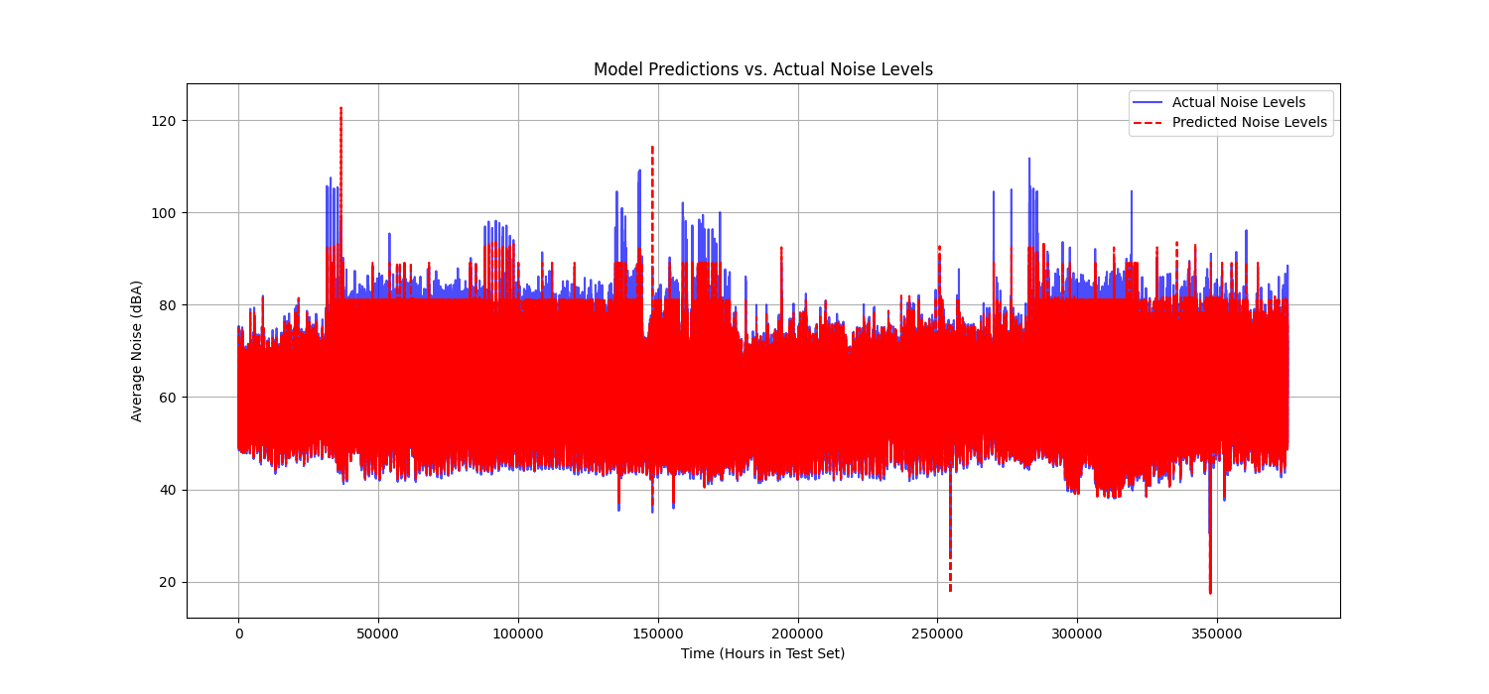
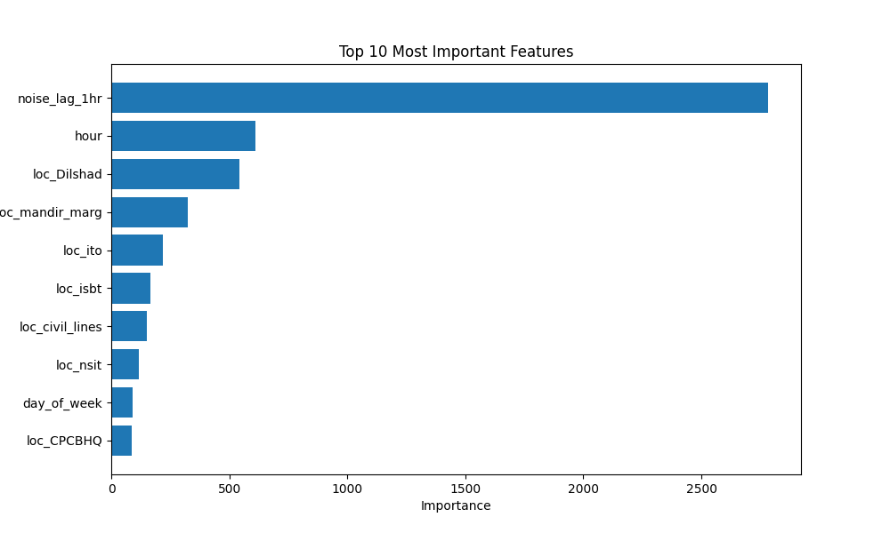
Predictive Modeling Insights
Model Performance: Highly Accurate
Mean Absolute Error (MAE): 1.33 dBA This means our model's forecast is, on average, off by only 1.33 decibels—a very low margin of error, indicating high accuracy.
Key Predictive Factors: What the Model Learned
1. Noise Lag (Previous Hour's Noise)
2. Hour of the Day
3. Location
Model Choice: Why LightGBM?
Powerful: As a gradient boosting model, it builds hundreds of decision trees in sequence, each one correcting the errors of the last. This allows it to learn complex, non-linear patterns.
Interpretable: Tell us which features are most important, providing invaluable insights into the drivers of noise pollution, unlike a NN.

Slide 12
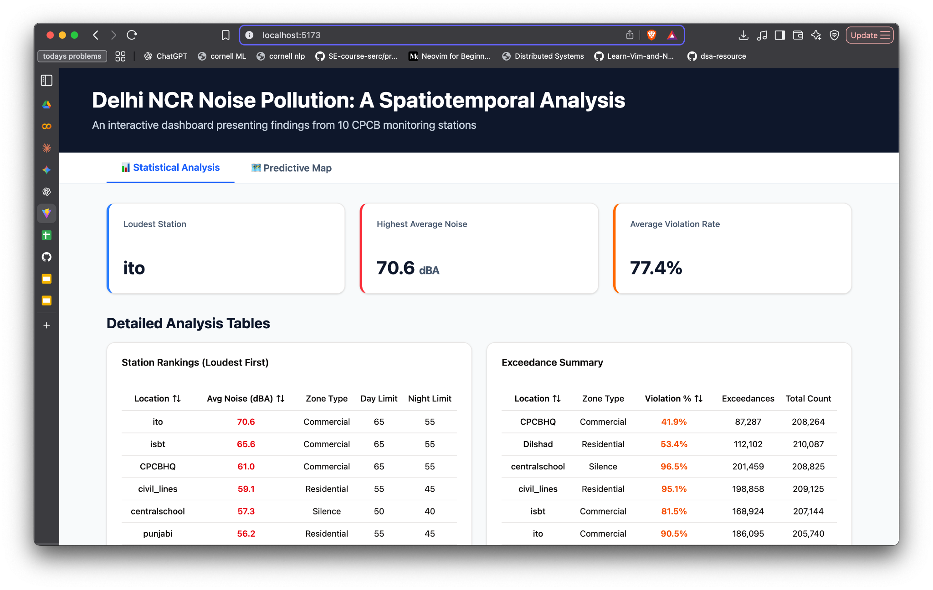
Interactive Dashboard Features
A live web application uses the ML model
A strong visual and statistical representation of the the analysed data
Users configure parameters like hour and day
Dashboard visualizes predictions on interactive map
This allows for powerful "what-if" scenario analysis

Slide 13

Future Directions
Targeted Intervention: Focus noise mitigation efforts and enforcement on the top 3 hotspots identified (e.g., ITO, ISBT).
Policy Simulation: Use the interactive dashboard to simulate the potential impact of policies, such as "no-honking" zones during predicted peak hours.
Public Awareness: Deploy the dashboard as a public-facing tool to raise awareness about noise pollution levels in different neighborhoods.

